Slide 1
Meowstastic Mentors: Purrfect Start Training for Staff and Volunteers
Dr Allison K Bliss
Director of Shelter Medicine

Slide 2
Introduction
Overview
Background
Stages of Development and Aging Kittens
General Health Information
How to Feed Kittens Based on Age
Weighing Kittens
Appetite Score
Fecal Score
Conditions that warrant Vet Services Involvement
Questions?
Purpose of training: To ensure consistent, high-quality care for neonatal and young kittens.
Goals: Improve kitten health outcomes, reduce fading kitten syndrome, and ensure early identification of illness.
Who this training is for: All staff and volunteers who interact with kittens under 8 weeks of age.

Slide 3
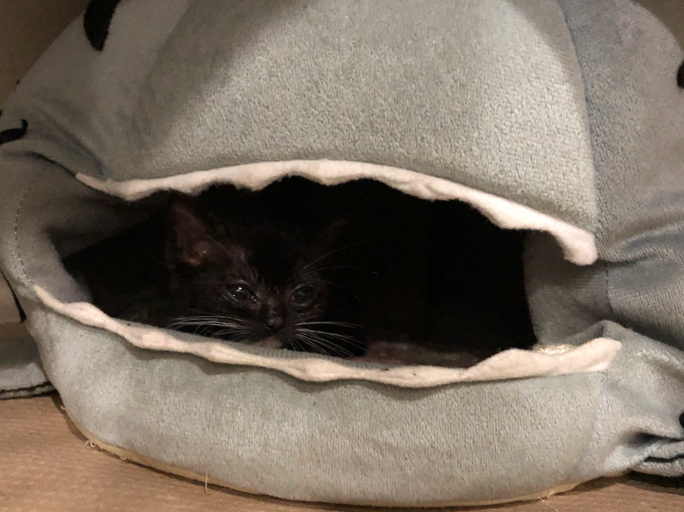
Background
Average kitten mortality: 11-36%
Body weight is the single moist important predictor of neonatal survival
Normal kittens gain 7-15g/day

Slide 4
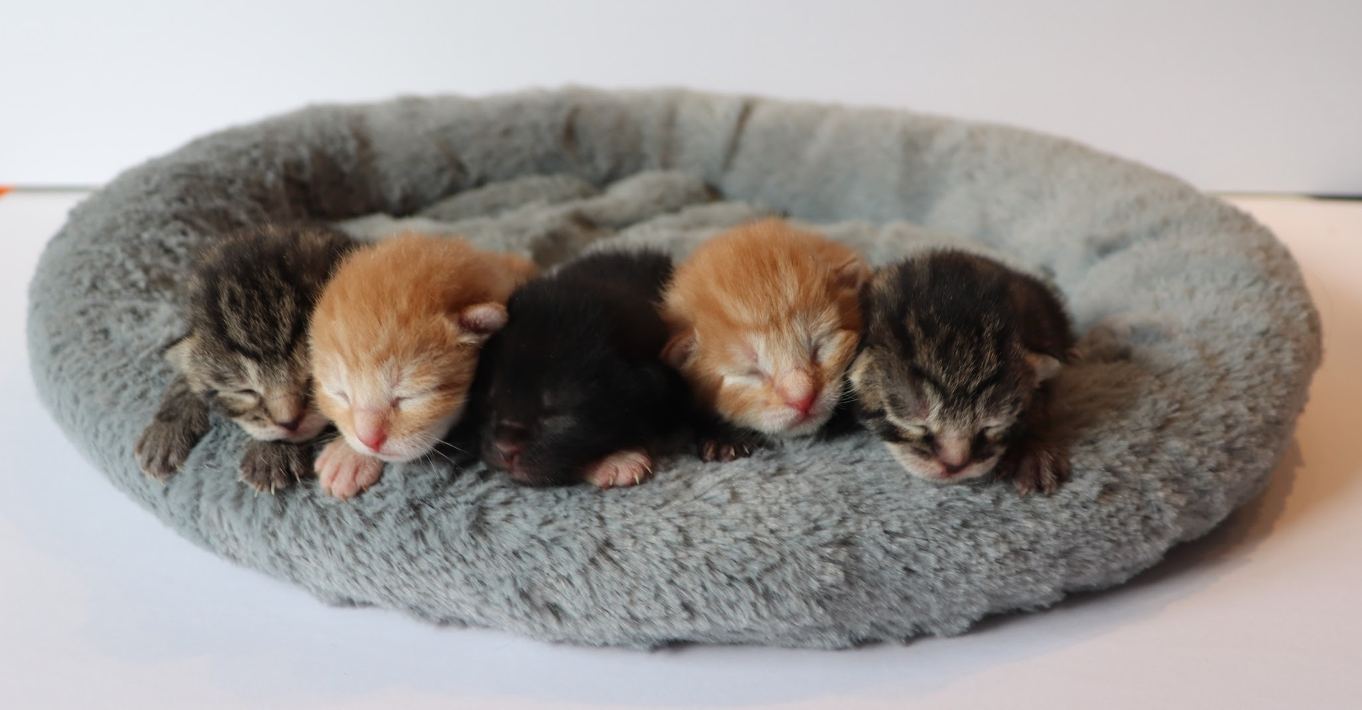
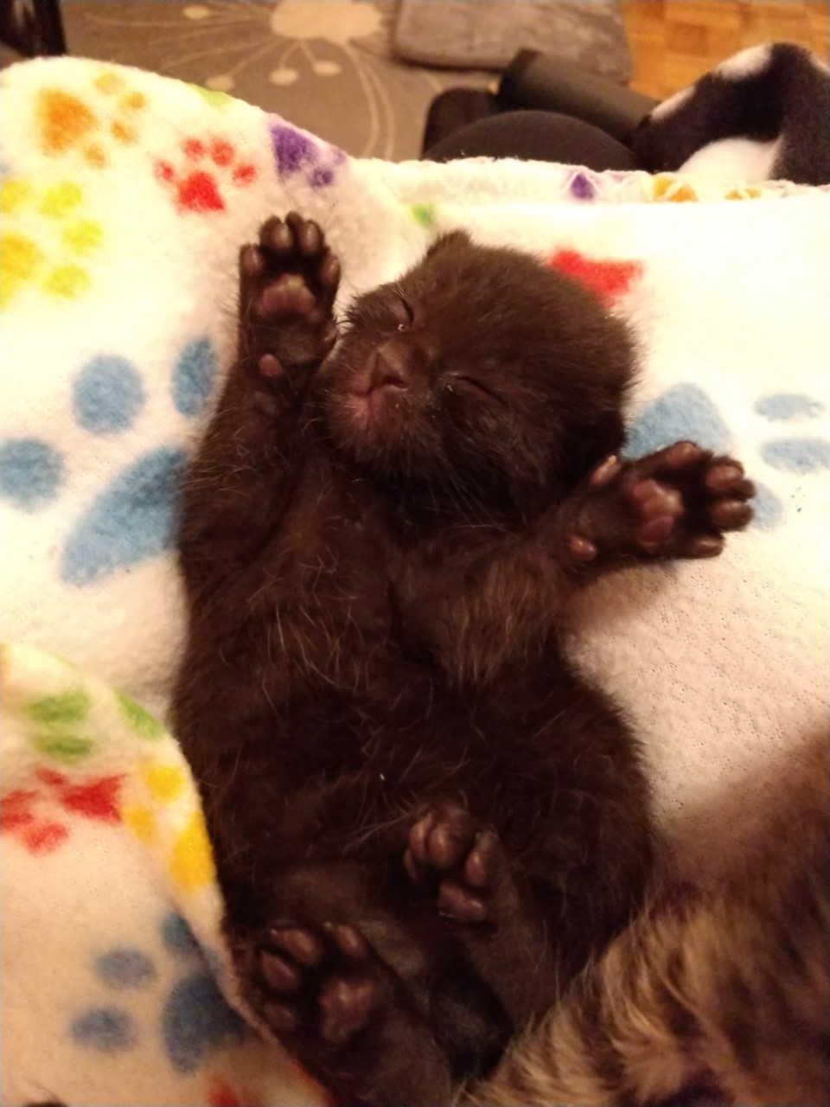
Stages of Development
Newborn:
  Umbilical cord attached
  Eyes closed
  Ears folded
  Can’t regulate body temp
1 Week:
  Eyes closed
  Ears folded
  No umbilical cord
  Eyes open 8-12 days

Slide 5
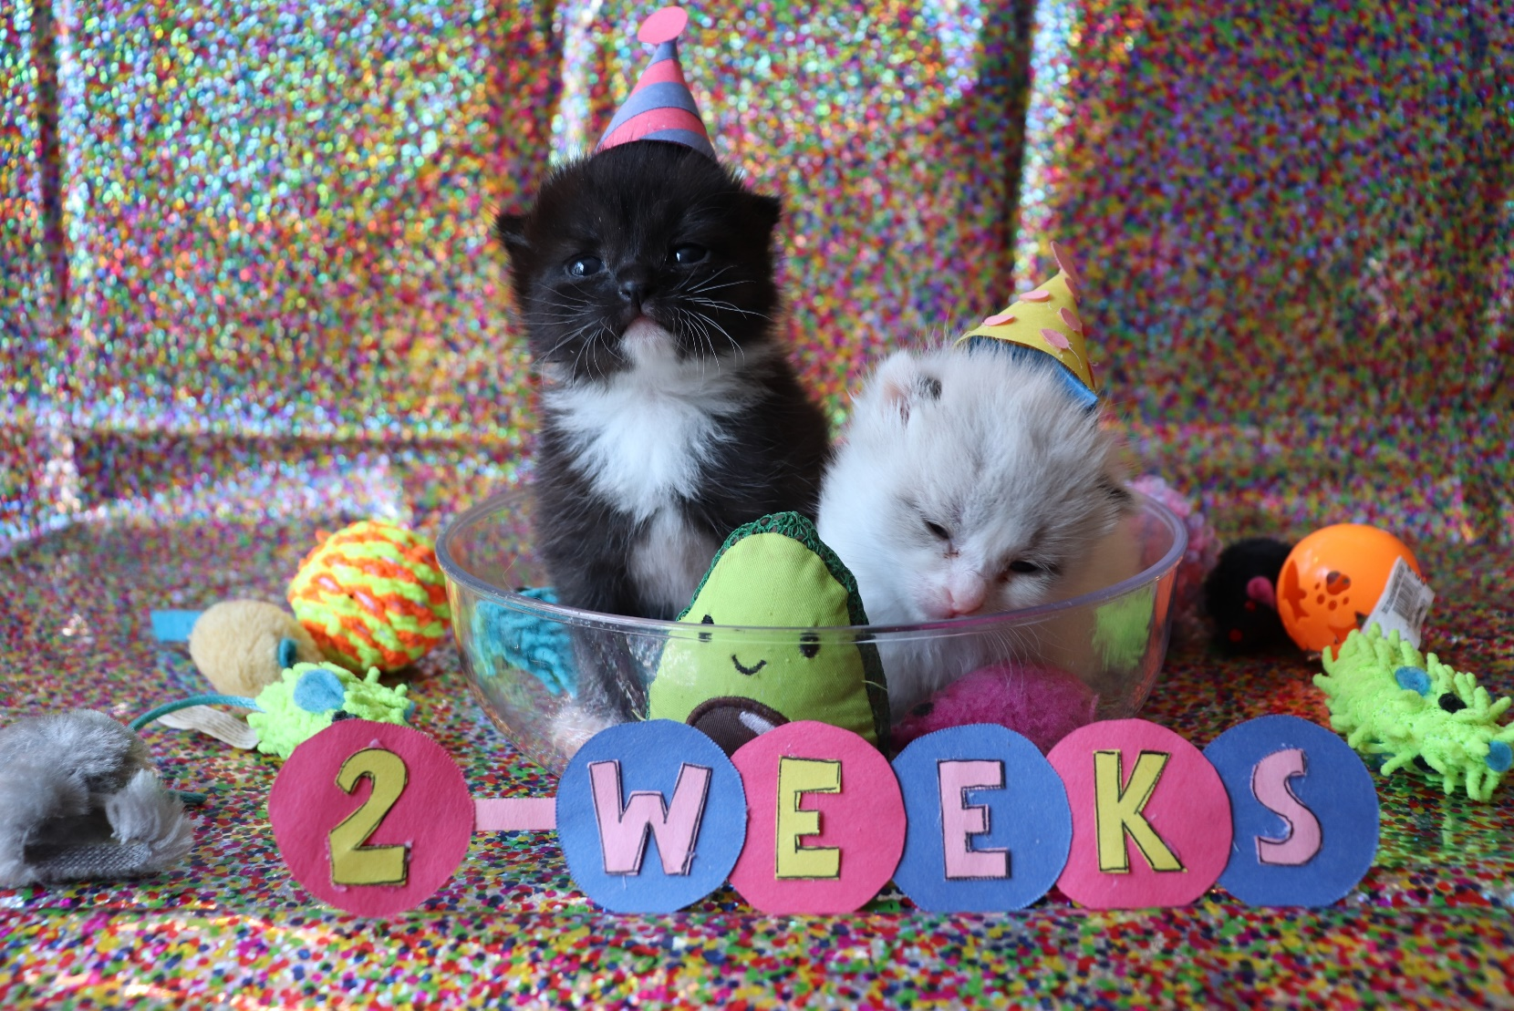
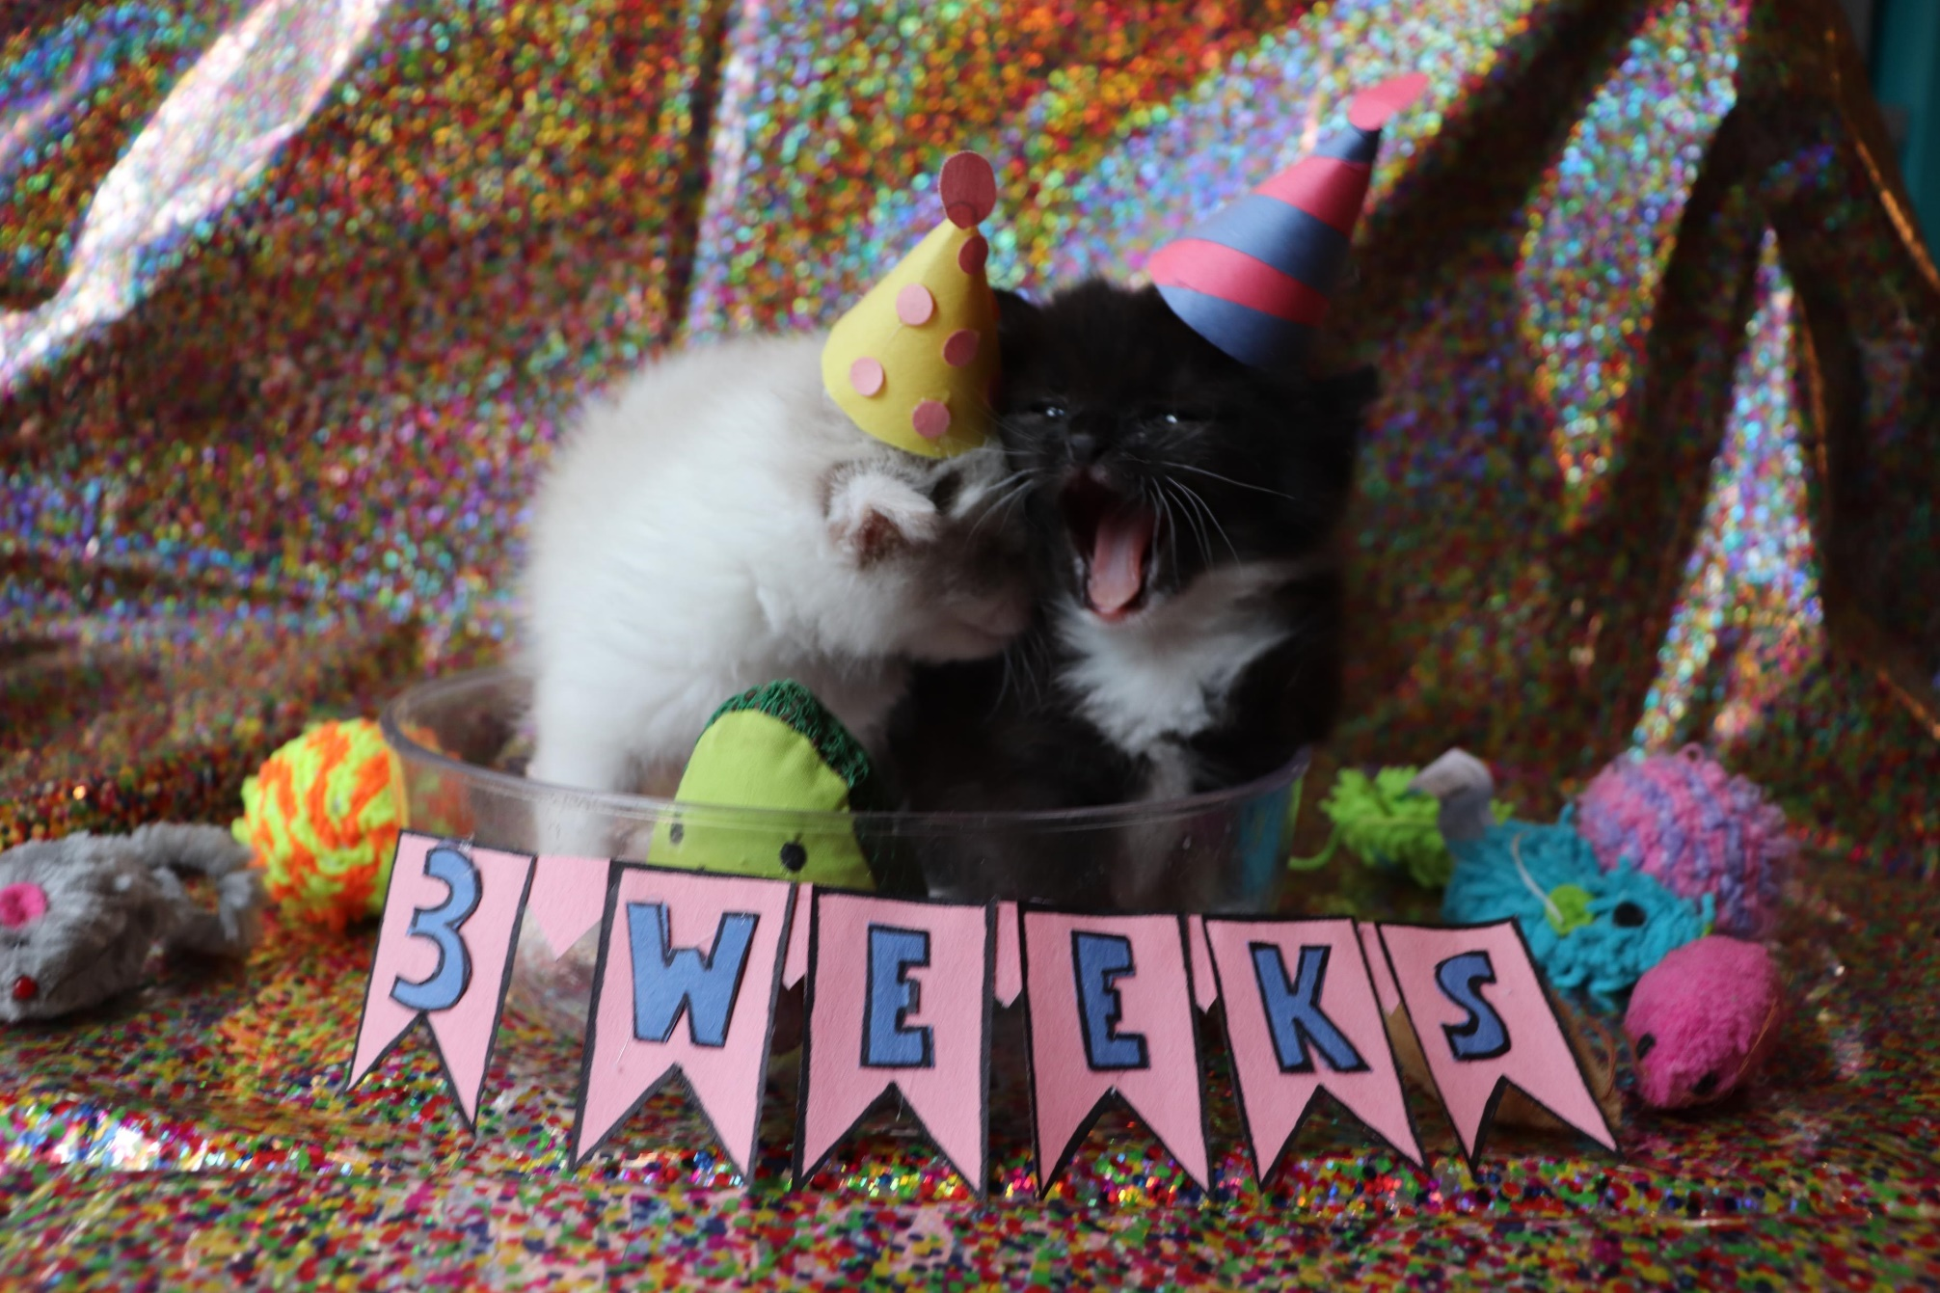
Stages of Development
2 Weeks:
    Eyes completely open
    Blue color
  Wobbly on their feet
3 Weeks:
  Incisors emerging
  Ears unfolded
  Discovering litterbox

Slide 6
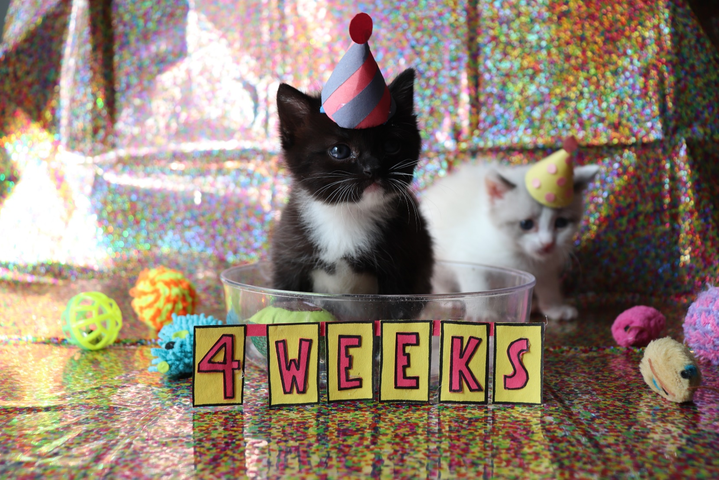
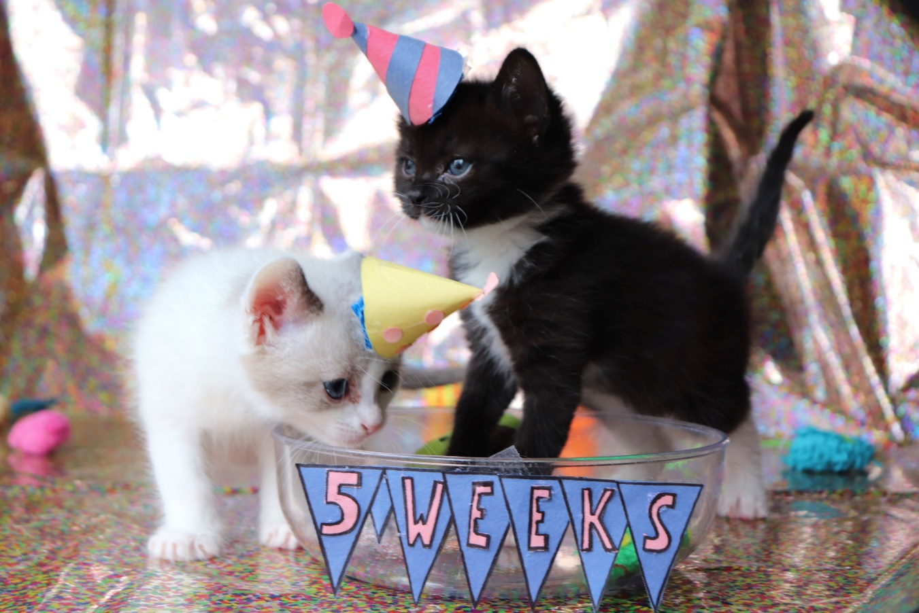
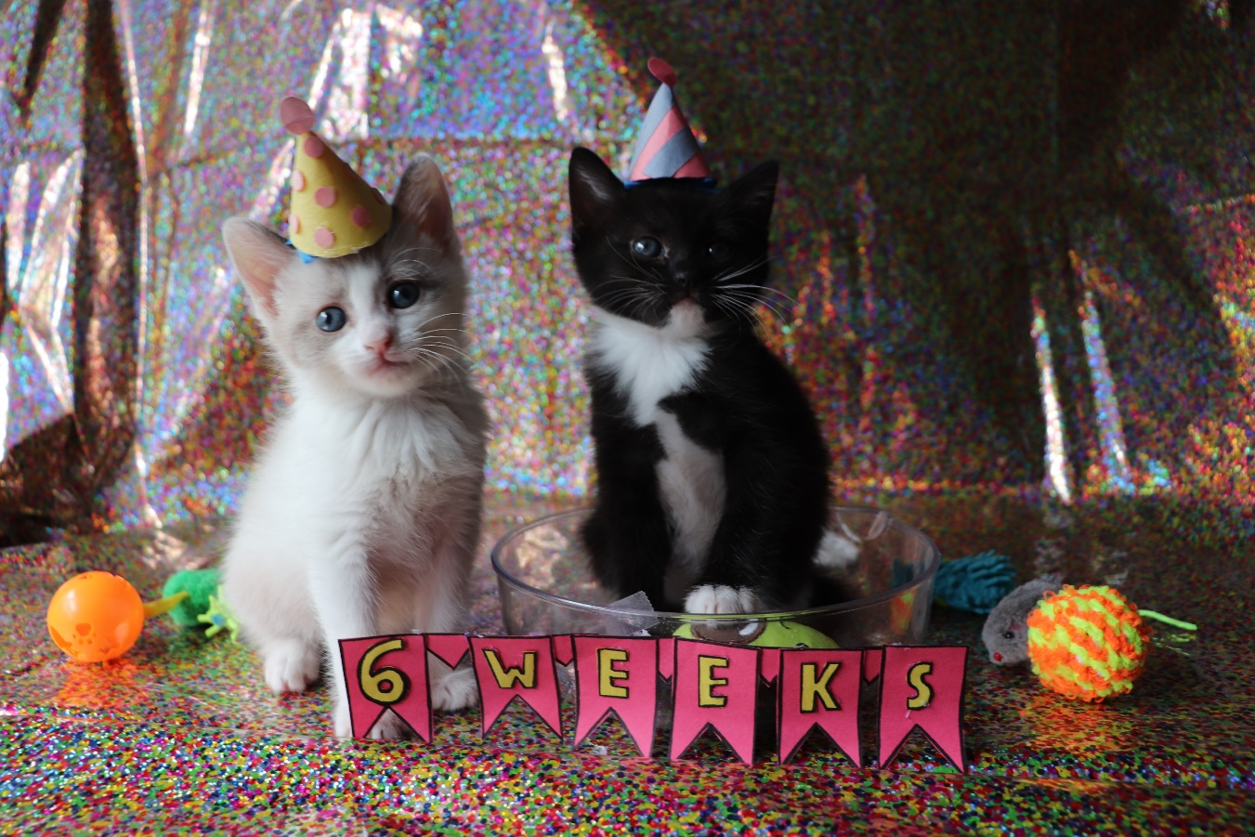
Stages of Development
4 Weeks:
  Canines emerging
  Vision improving
  Walking confidently
5 and 6 Weeks

Slide 7
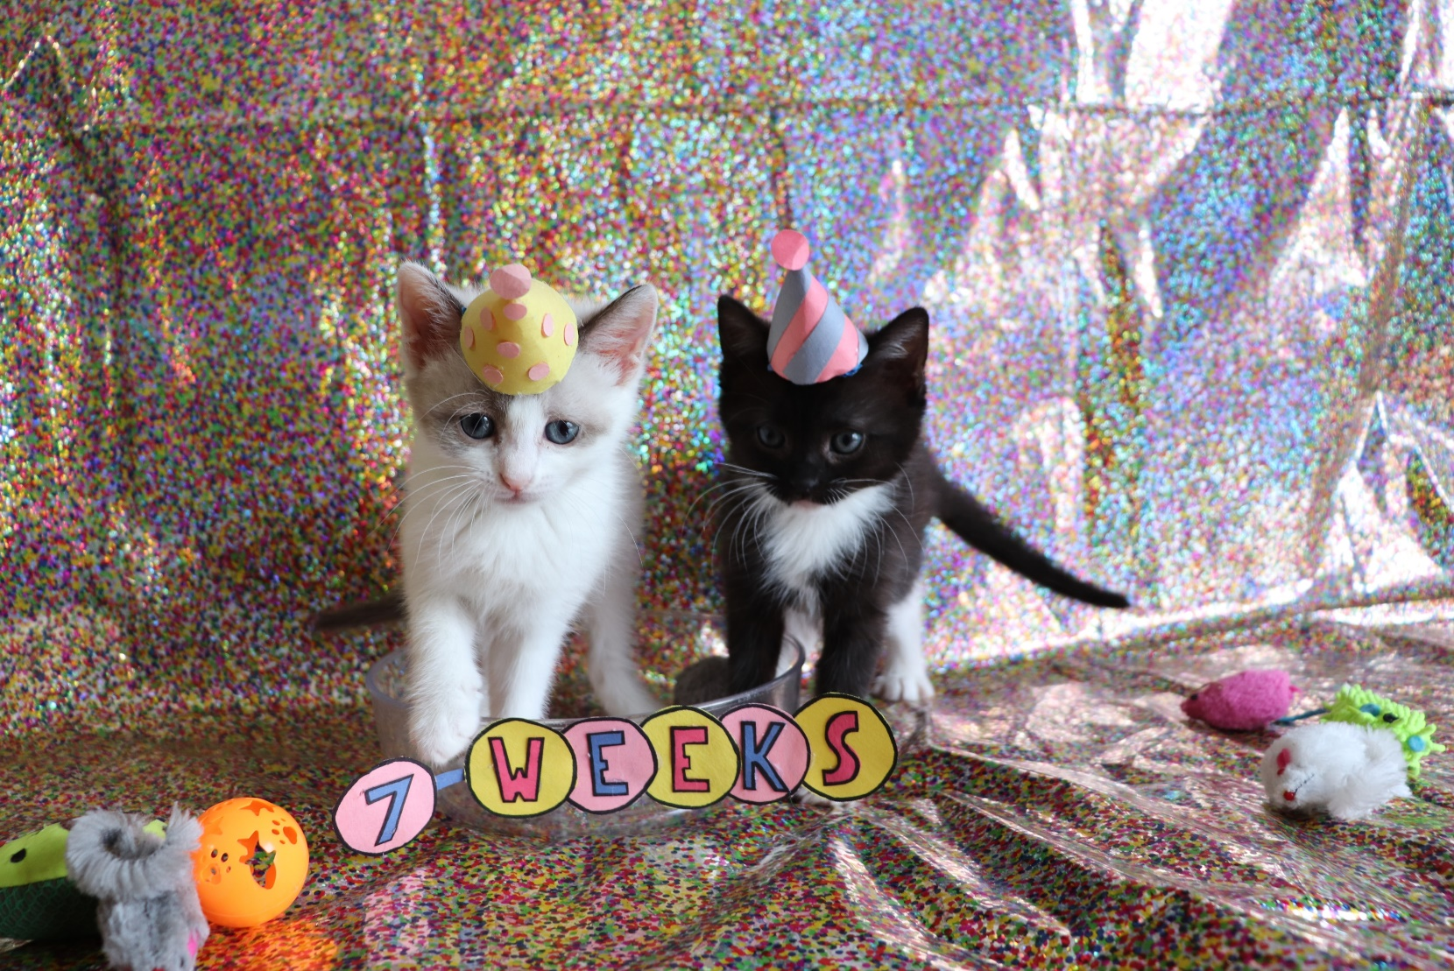
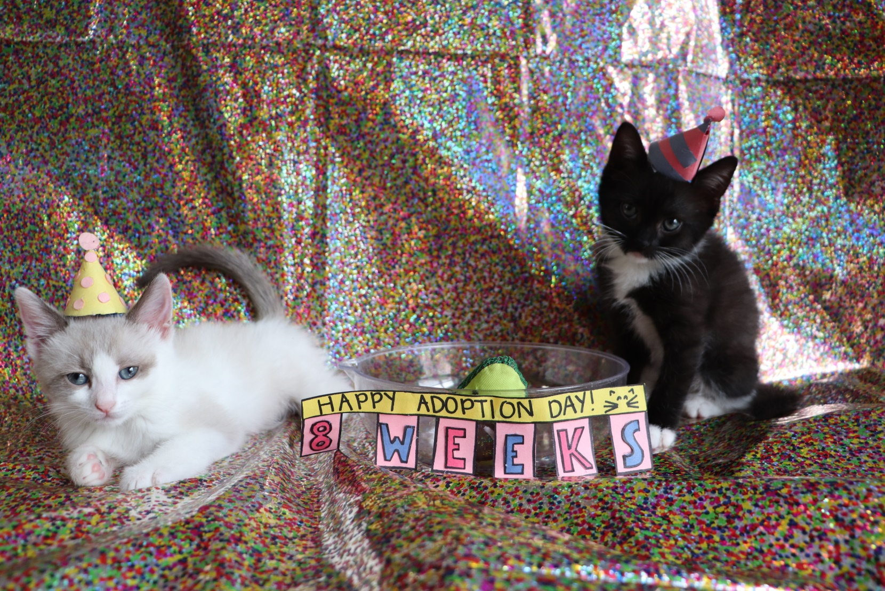
Stages of Development
7 Weeks:
  Transitioning to adult eye color
  Coordinated and playful
8 Weeks:
  Adult eye color
  Ready for spay/neuter at 909g (2lbs)

Slide 8
General Health Information
Heart Rate | < 2 weeks 220-260 bpm |  | > 2 weeks 180-220 bpm
Respiratory Rate | < 1 wk 10-18 breaths/min | 1-2 wks 15-35 breaths/min |  | > 2 wks 16-32 breaths/min
Temperature | < 1 wk 95-99°F |  | 2-3 wks 97-100°F |  | > 4 wks 99-101°F
Blood Glucose* | All ages 90-140 mg/dL

Slide 9
Orphaned Kittens Temperature Chart¹
Age of Kitten | Rectal Temperature | Ambient Nest Temperature | Room Humidity
0-1 weeks | 95-99°F | 85-90°F | 55-60%
2-3 weeks | 97-100°F | 79-84°F | 55-60%
4 weeks | 99-101°F | 73.5-79°F | 55-60%
¹Temperature chart from Maddie’s Fund (www.maddiesfund.org)

Slide 10
How to Feed Kittens Based on Age
Category | Age | Heat Source | What to Feed? | How Often to Feed? | Stimulate?
Bottle Beanlings | 0-2 weeks | Yes! | KMR | Q3hrs (no more than 5-6hr break overnight) | Yes, at every feeding
Bottle Blinkers | 2-4 weeks | Yes! | KMR | Q5hrs (no more than 8hr break overnight) | Yes, at every feeding*
Weaning Wobblers | 4-6 weeks | Situational | 1 Tbsp wet kitten food | Q5hrs (4x daily) with 8hr break overnight | No
Pouncelets | 6-8+ weeks | Situational | 2 Tbsp wet kitten food | Q8hrs | No
Notes:
A Note on Kitten Transitional Feeding
Appropriate age (4 weeks with signs of canines erupting)
Supplies
Don’t rush
Introduce water and dry food

Slide 11
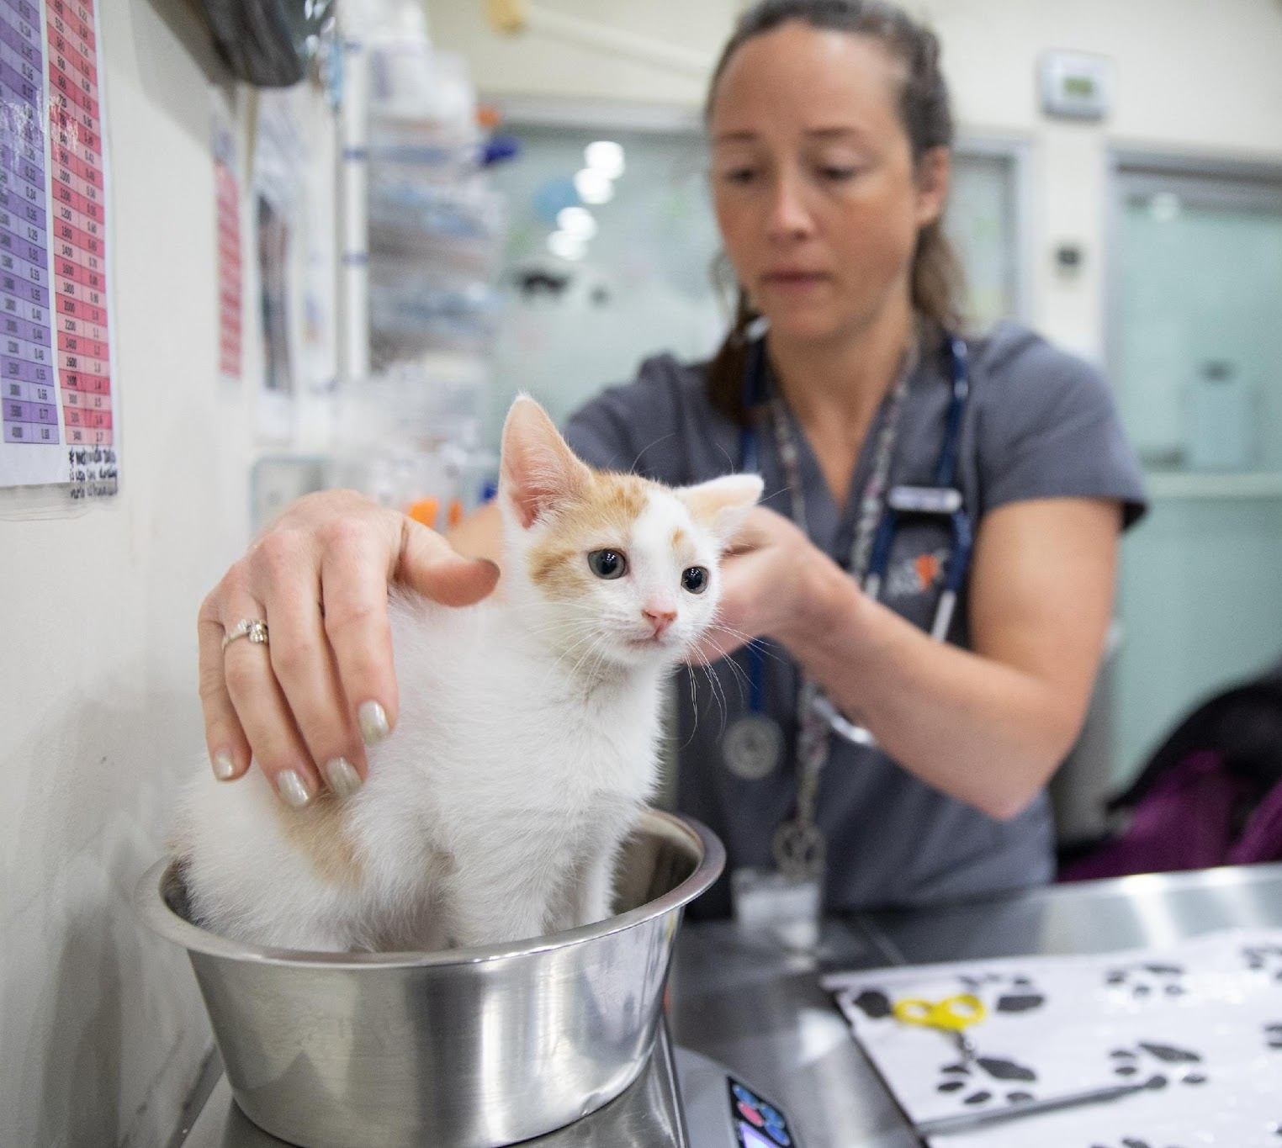
Weighing Kittens
Essential
At least once daily
Should gain ~7-14 grams per day
Not gaining, or losing weight could be the first sign of illness and should be addressed immediately

Slide 12
Kitten Bottle Feeding and Stomach Capacity Chart
Estimated Kitten Age (weeks) | Kitten Weight (grams) | Daily Caloric Requirement* | Amount of Formula Per Day (ml)** | Amount Per Feeding (ml)* | Approximate Number of Feedings Per Day***
< 1 week | 57-113 g | 11-23 kcal | 15-31 ml | 2-5 ml | 7
1 week | 142-227g | 28-45 kcal | 38-61 ml | 6-9 ml | 7
2 weeks | 255-312 g | 51-62 kcal | 69-84 ml | 10-12 ml | 6-7
3 weeks⁺ | 340-425 g | 68-85 kcal | 92-115 ml | 14-17 ml | 5-7
4 weeks⁺ | 454-539 g | 91-108 kcal | 123-146 ml | 18-22 ml | 4-5
5 weeks⁺ | 567g | 113 kcal | 153 ml | 23 ml | 4
https://www.maddiesfund.org/assets/documents/institute/kitten%20bottle%20feeding%20and%20stomach%20capacity%20chart.pdf

Slide 13
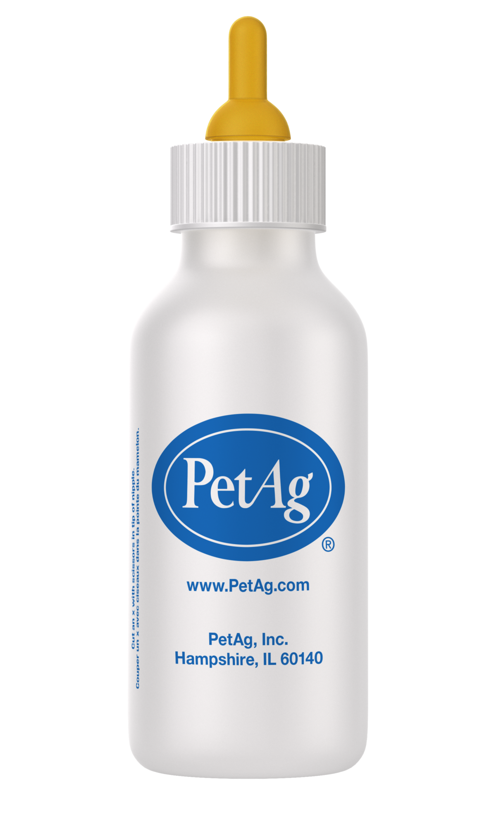
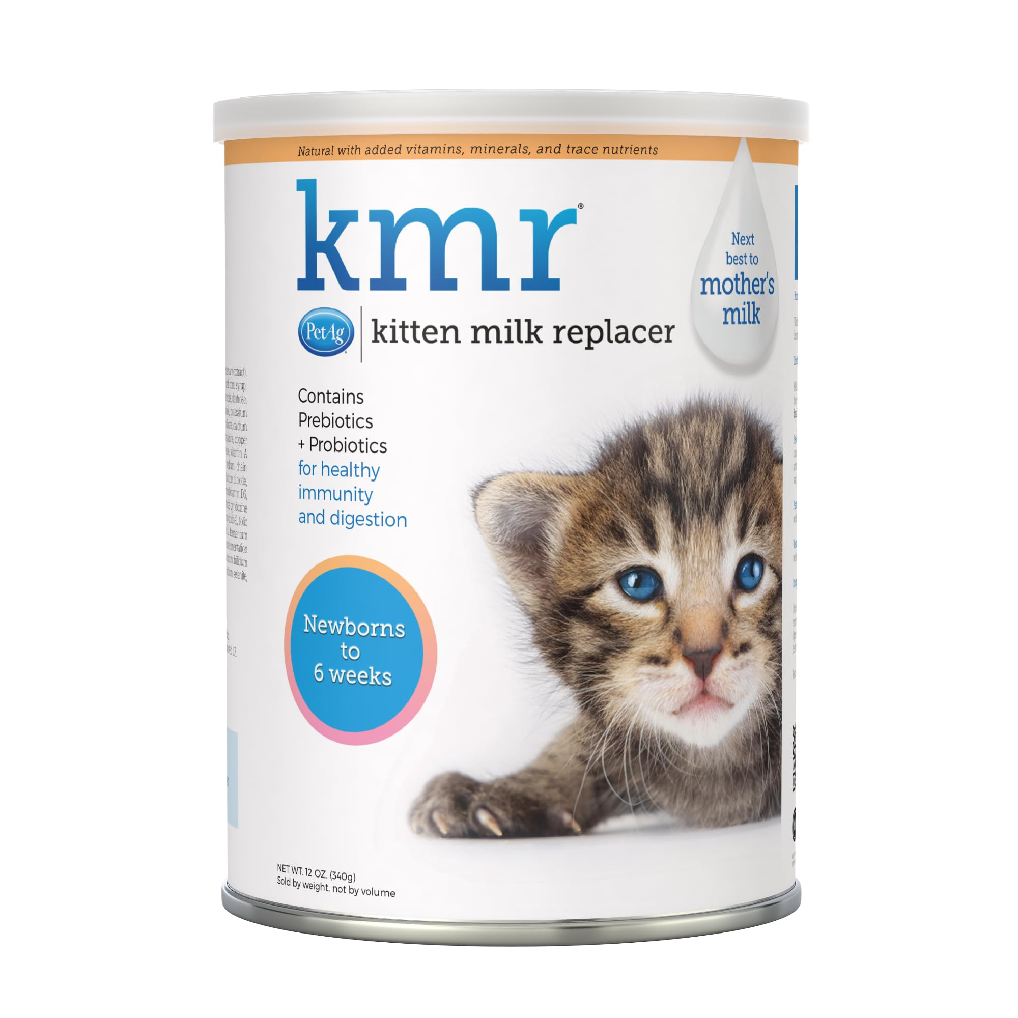

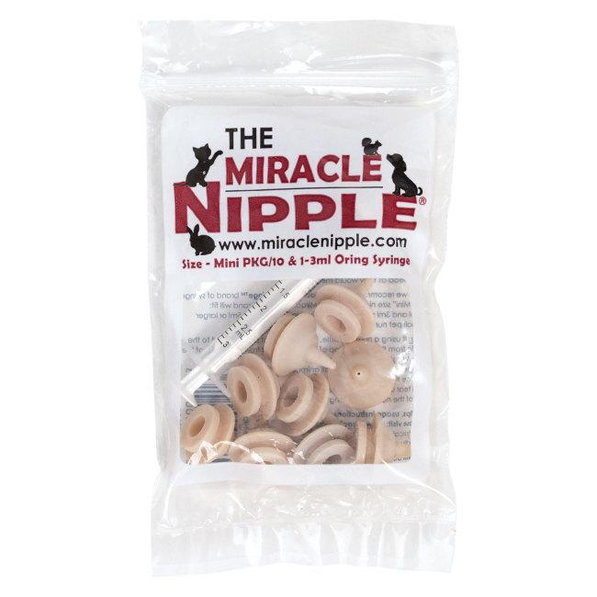
Milk Replacer, Bottle and Nipple
Mixing Directions
Whisk or shake 1-part powdered milk replacer into 2 parts warm water. Do not mix more milk replacer than can be consumed in 24 hours. Mix well using blender bottle.
Storage
Unopened container should be stored in a cool, dry place. Opened container can be kept at room temperature for up to 2 months and then must be refrigerated (up to 1 additional month). Opened container can be frozen for up to 6 months to preserve freshness. Use product before best by date stamped on container. Reconstituted liquid must be kept refrigerated for up to 24 hours.

Slide 14
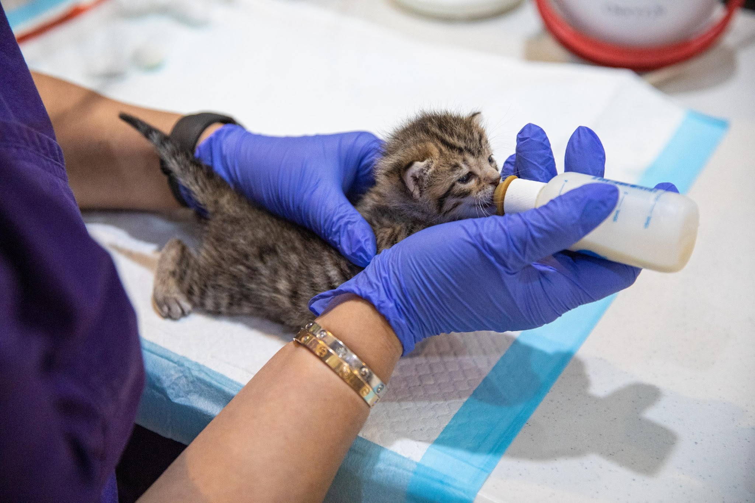
Assessing the Kitten and Proper Position
Assessing the Kitten
Is the kitten too cold?
  Temp < 95 F
Is the kitten too hot?
  Temp > 102.5 F
Is the kitten swallowing?
Proper Position
On stomach (never on back like a baby!)
Stabilize head
Gently slide nipple into kitten’s mouth
Kitten should latch and begin to swallow

Slide 15
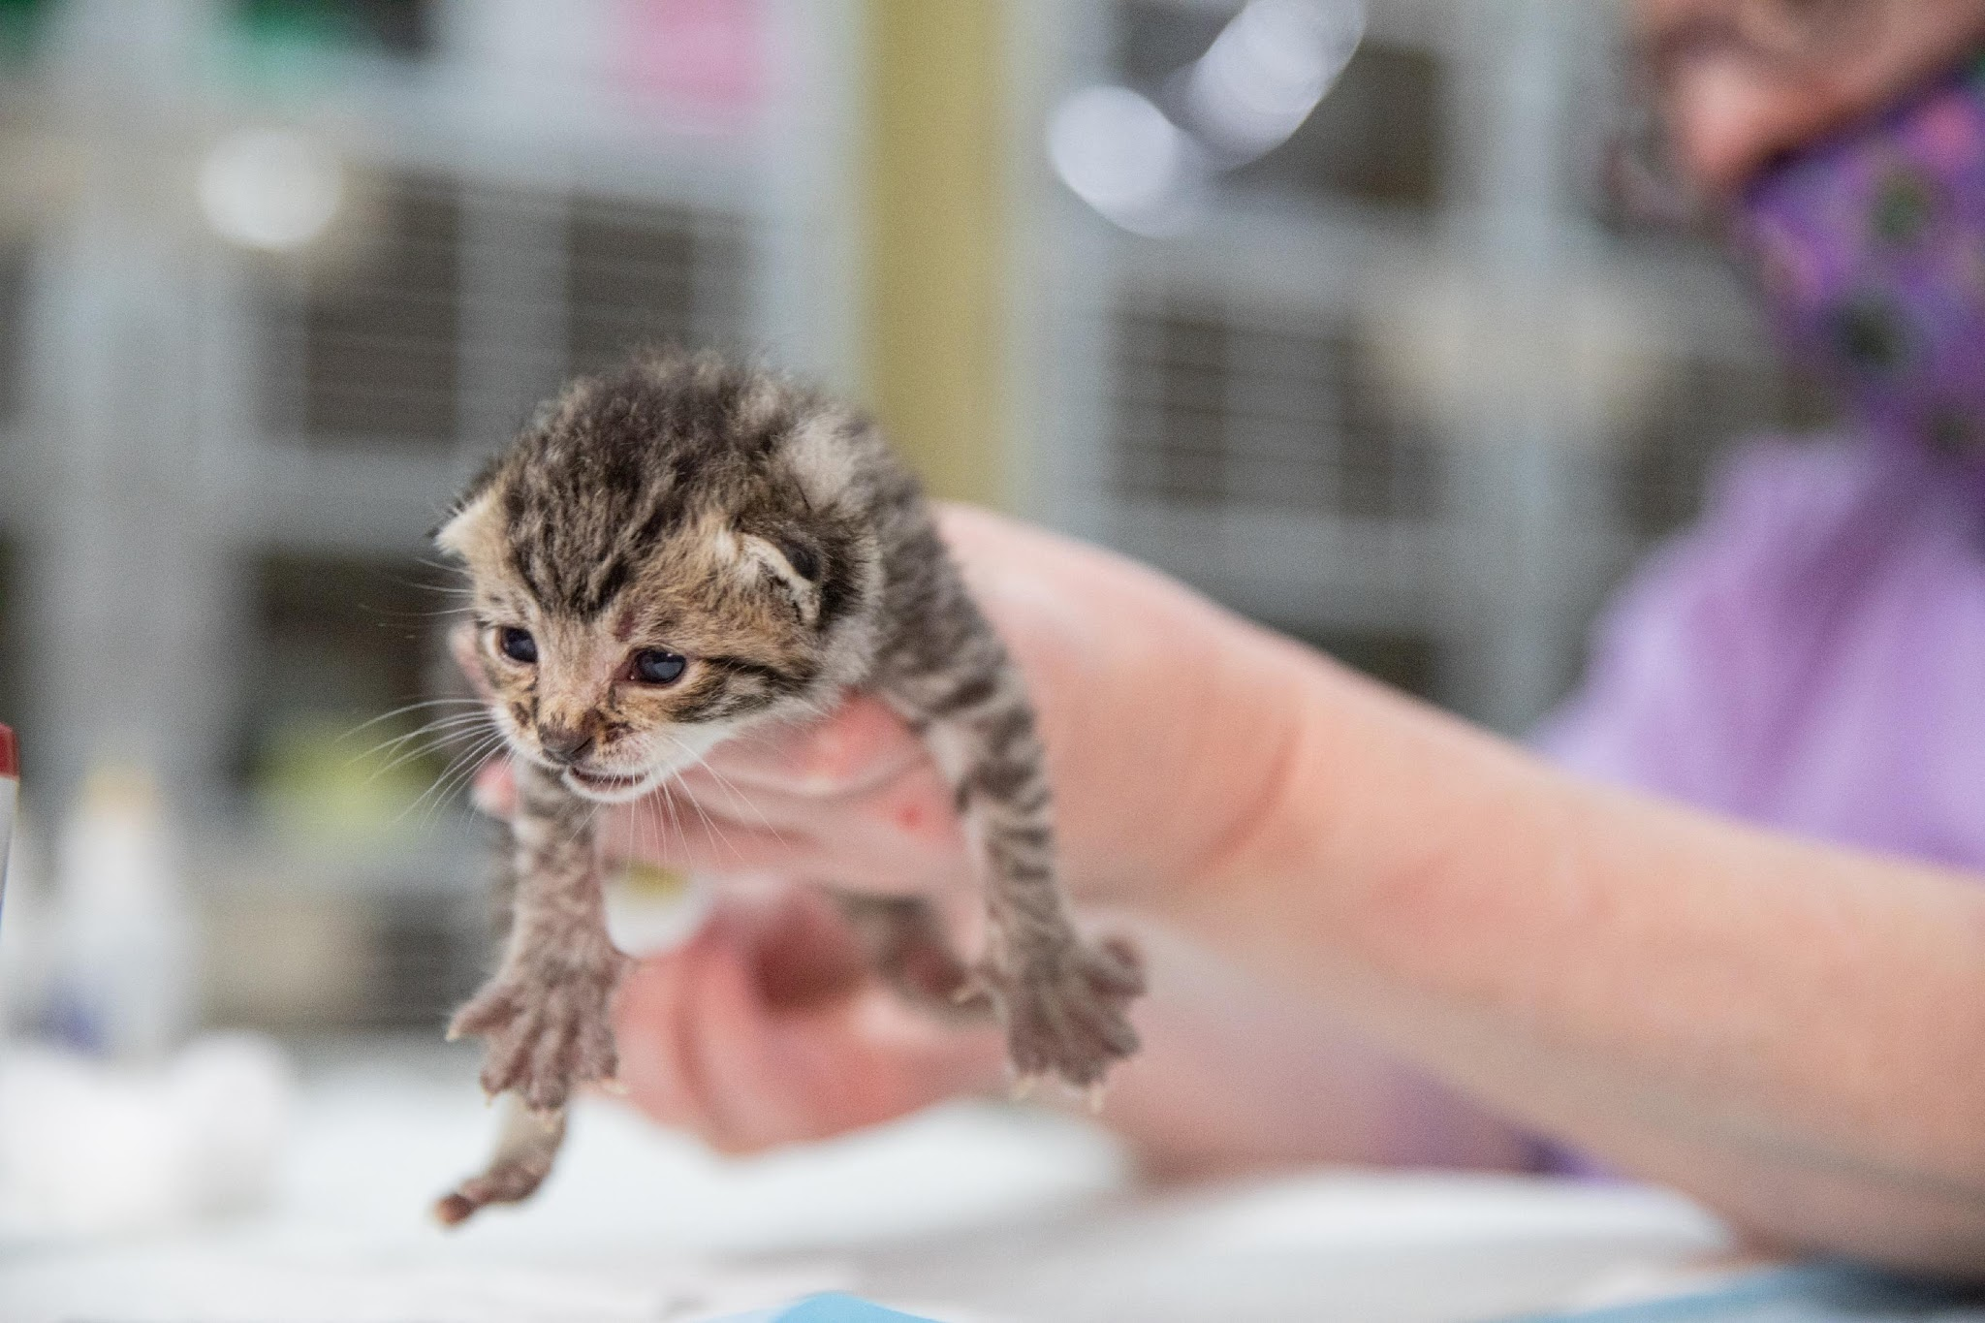
Stimulating
Soft, absorbent material (e.g., cotton ball, baby wipe, etc.)
Position
Gently rub anogenital region in circular motion
Pee at every feeding
Poop at least once a day
Monitor
Clean

Slide 16
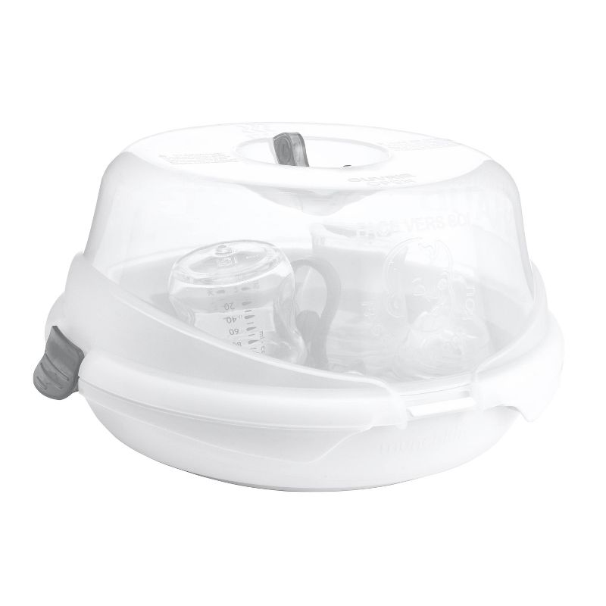
Clean Up
Hand-wash bottle(s), use a small brush and a drop of dishwashing liquid to clean the bottle and nipple
Bottle Sanitizing
  Add water to the sterilizer as directed. Load the bottle parts into the sterilizer, ensuring they are properly positioned. Place the sterilizer in the microwave and run for the recommended time based on your microwave's wattage.

Slide 17
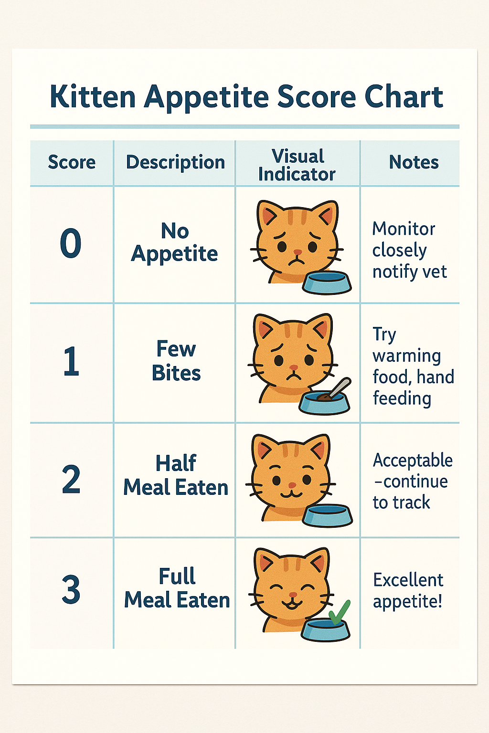
Appetite Score
Anorexia = AS 0
Inappetence = AS 1
When to notify Vet Serv for bottle fed kittens
  Less than 2mLs of KMR for kittens under 1week
  Less than 6mLs of KMR for kittens 2-3 weeks
  Less than 10mLs of KMR for kittens 3-4 weeks

Slide 18
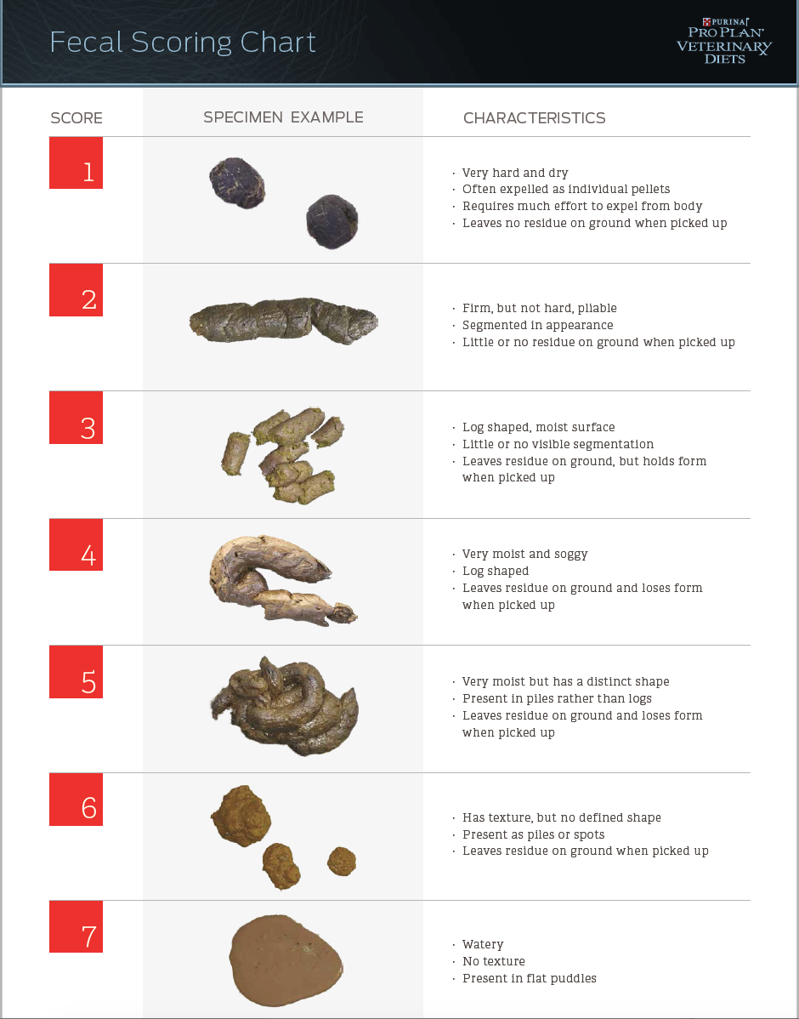
Let’s Talk About Poop
Normal FS for kittens is 2-5
  1 = constipation
  6 or 7 = diarrhea

Slide 19
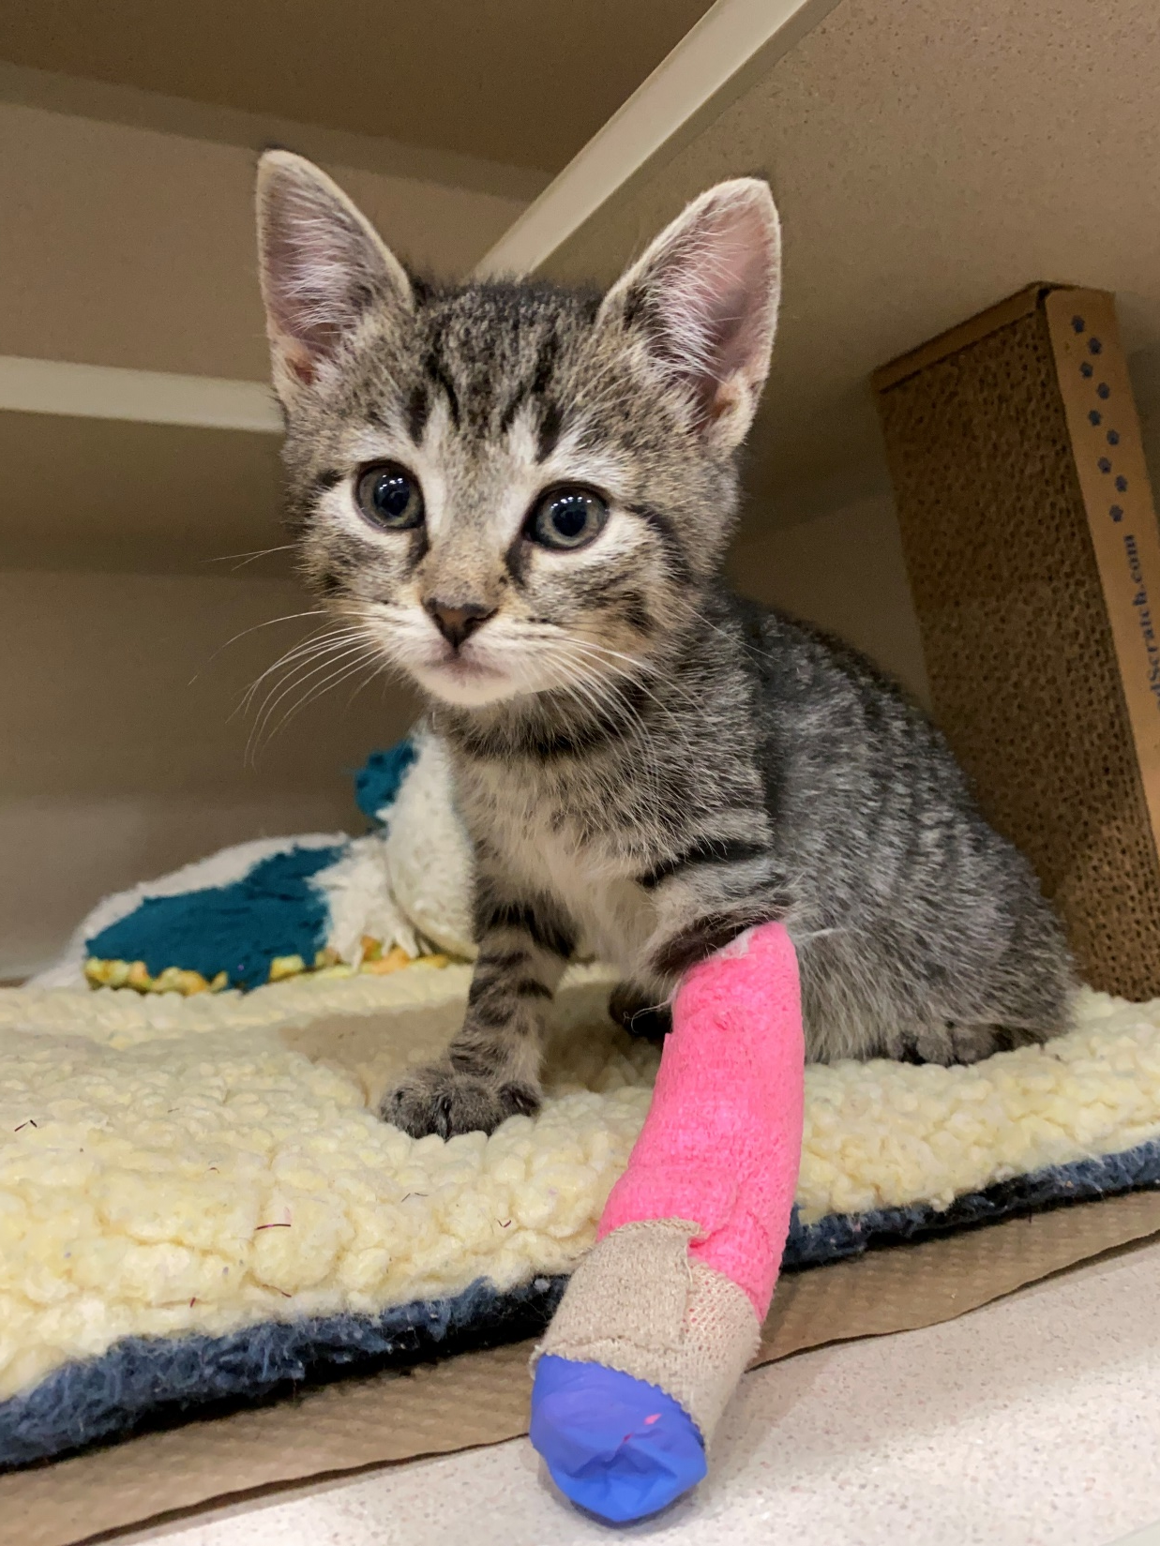
Conditions that Warrant Vet Services Involvement
Anorexia/inappetence (not eating)
Weight loss (10% overnight or gradual loss over 3 days)
Vomiting
Lethargy
Hypothermia (<97F) or hyperthermia (>102.5F)
FS 6 or 7
Pale or tacky mm
Any ocular or nasal discharge
Increased RR and/or labored breathing
No BM for 48hrs or straining to defecate with no production
Any neurologic signs
Any lameness or significant wounds
Alopecia (hair loss) and Wood’s positive
Any significant clinical signs that do not fall into the above or appear otherwise of concern

Slide 20
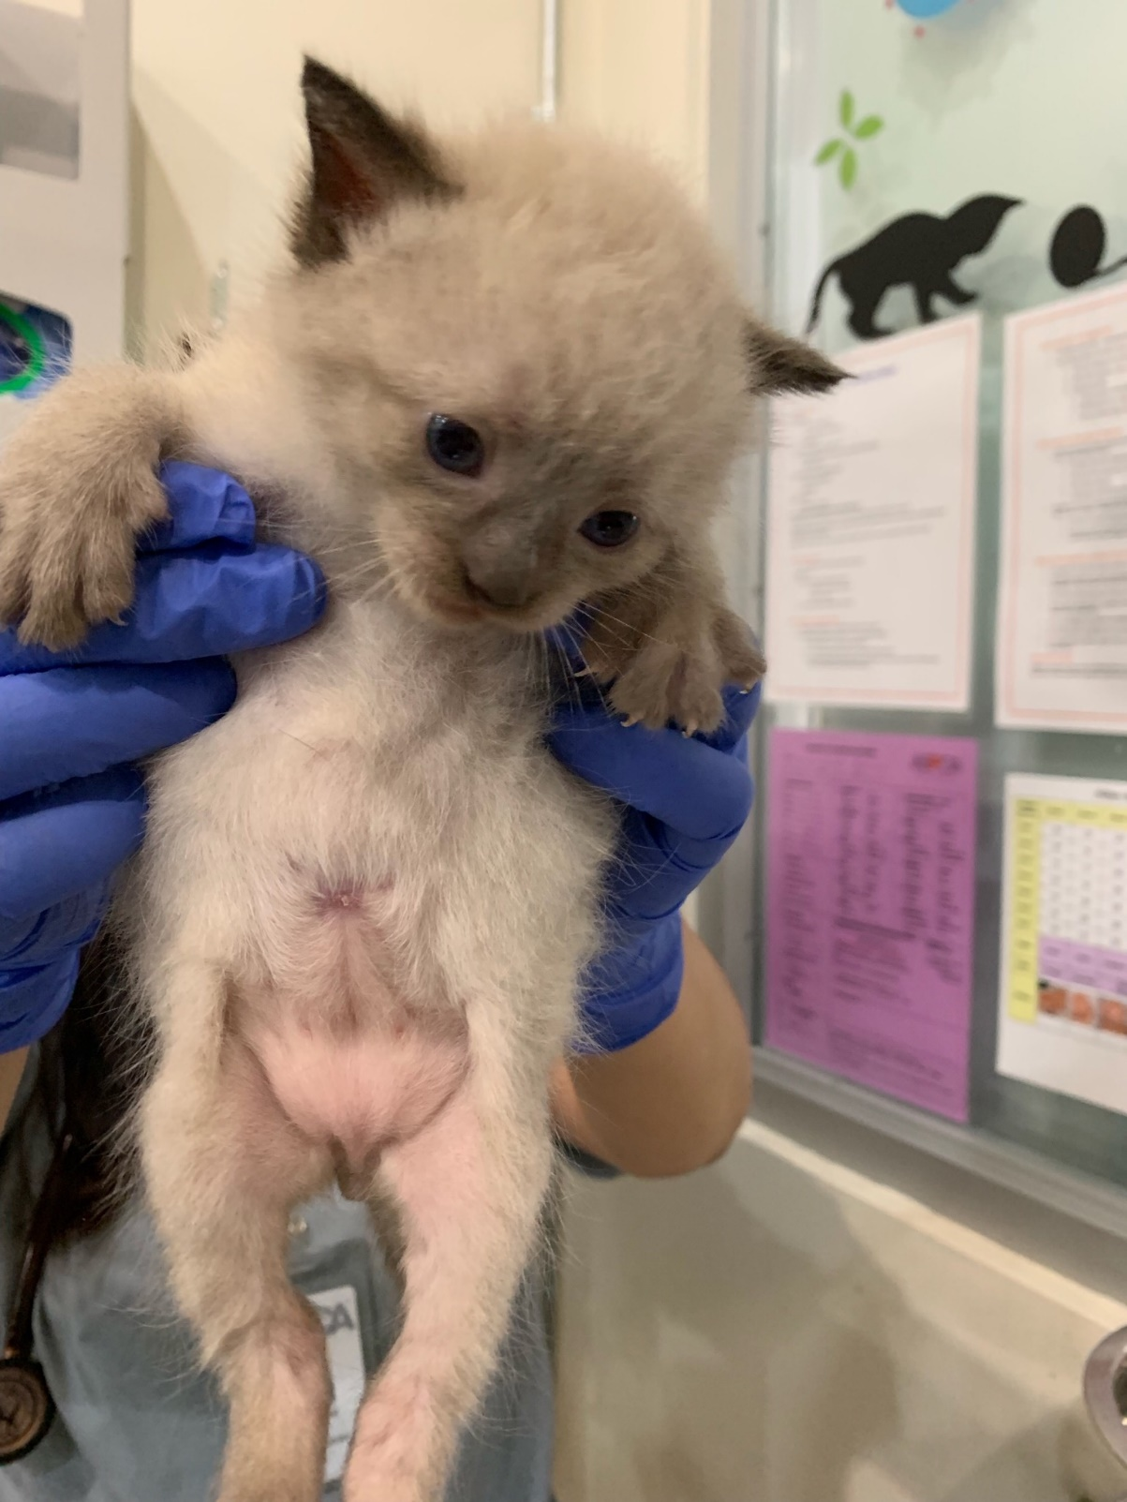
Questions?

Slide 21
Resources
https://www.alleycat.org/
https://kittencoalition.org/
https://www.kittenlady.org/
MADDIE'S UNIVERSITY: KITTEN & PUPPY CARE
UC DAVIS KORET SHELTER MEDICINE PROGRAM: Caring for Kittens from Birth to Eight Weeks

